Slide 1
EF-EP-004-MCB
EPIC:
Products Selection (Dealer & Vehicle)

Slide 2
EF-EP-004: Products Selection (Dealer & Vehicle)
Story ID: ES-S 001:
As a user I want to select the vehicle so that I can start the finance application process
Story ID: ES-S 002:
As a user I want to have the information of the vehicle displayed (pictures, options,...) so that I can see which car I want to purchase / finance.
Story ID: ES-S 003:
XXX
Story ID: ES-S 004:
As a user I want to chose the dealership of the car I would like to purchase / finance so that I can continue the process later on in my next visit and so that I can get the dealer specific vehicle / finance product.
Story ID: ES-S 005:
As a user I want to adjust the MSRP to the agreed quotation price so that I can finance the quotation price & so that I can get a binding offer from the dealer
Story ID: ES-S 006:
As a user I want the Dealer automatically pre-filled so that I don't have to search for the specific dealer

Slide 3
Story ID: ES-S 001:
OWNER: PO (BA)
Business
Legal
As a user I want to select the vehicle so that I can start the finance application process
Assumptions:
The vehicle and the transaction price is already negotiated offline between user and sales manager.
No pipeline check necessary.
User is logged in / registered.
Pre-Conditions:
XXX
Acceptance Criteria:
The user selected the Brand BMW / MINI and the CI is changing to either BMW or MINI.
The user selected the vehicle series by clicking / swiping. A picture of the respective series is displayed.
The user selected the vehicle model (drop down)
The user selected the vehicle package (drop down)
The MSRP of the selected vehicle series, model & package is displayed
IT
Compliance

Slide 4
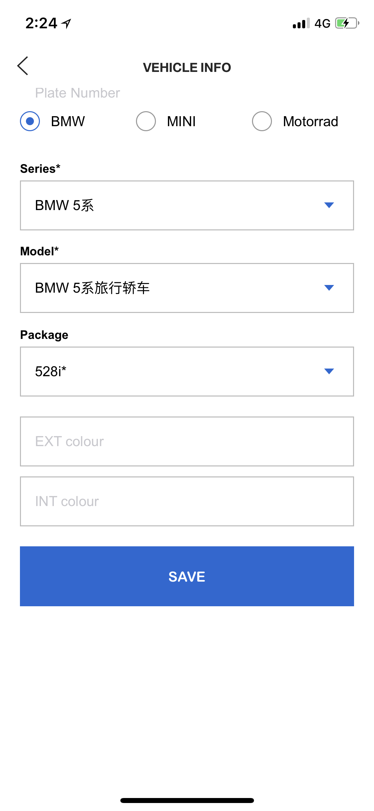
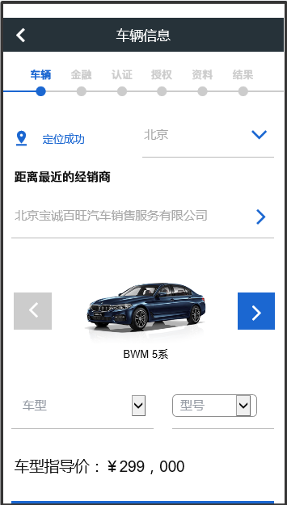
Story ID: ES-S 001
Mockups:
Solution 2
Solution 1
Or
Model
Package
Vehicle selection for customer should be easy, only include series, model, packages.
As in Solution 2, it would be better if use vehicle picture to show with series selection.
Correct Chinese and English would also be considered.

Slide 5
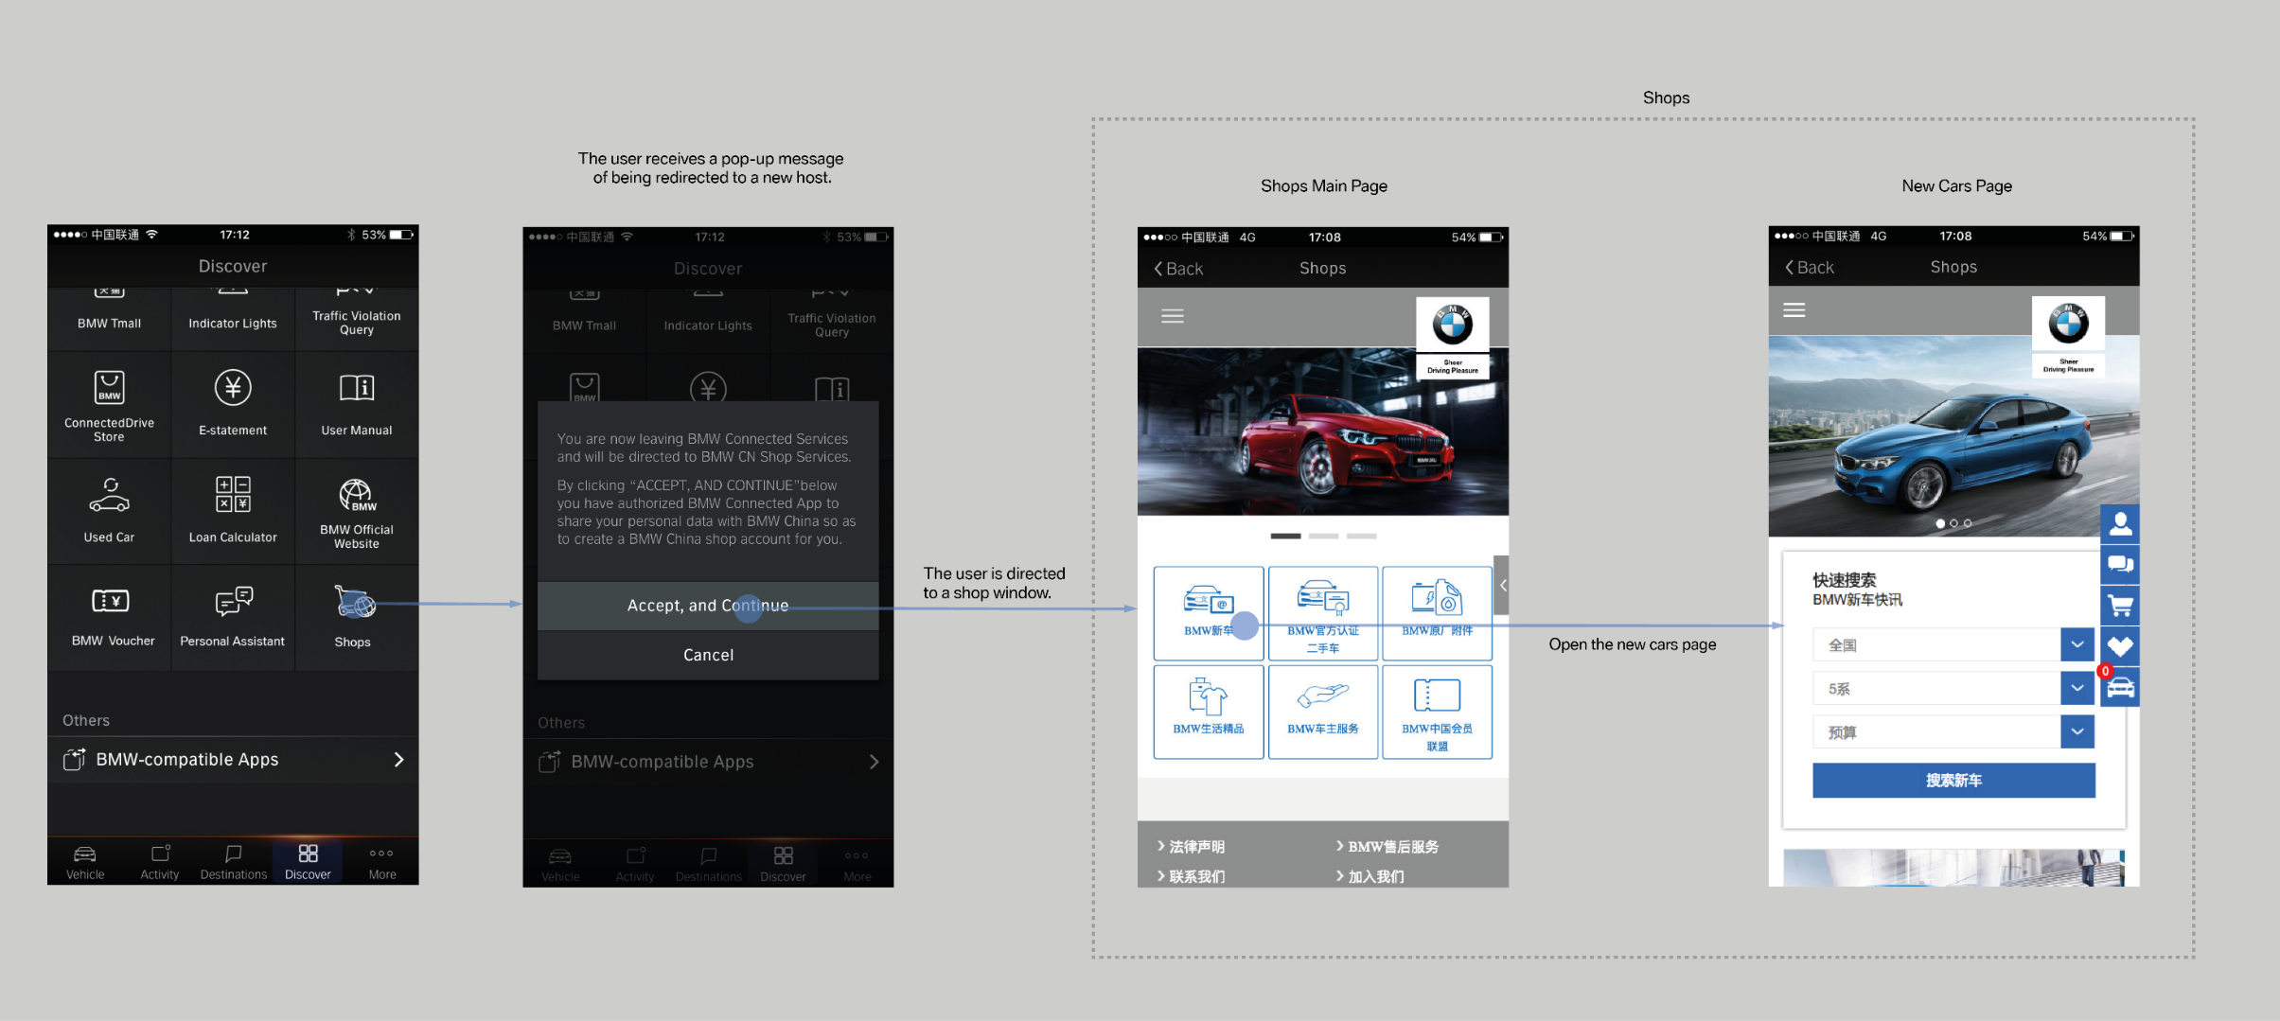
Story ID: ES-S 001
Wireframes
Sample

Slide 6
Story ID: ES-S 001
Process Flow:
Easy Finance APP
Registration
Process

Slide 7
Story ID: ES-S 001
Sequence Flow

Slide 8
Story ID: ES-S 002:
OWNER: PO (BA)
Business
Legal
As a user I want to have the information of the vehicle displayed (pictures, options,...)
so that I can see which car I want to purchase / finance.
Assumptions:
The vehicle and the transaction price is already negotiated offline between user and sales manager.
No pipeline check necessary.
User is logged in / registered.
Pre-Conditions:
XXX
Acceptance Criteria:
The user selected the vehicle series by clicking / swiping. A picture of the respective series is displayed.
Options of the vehicle can be selected the prices / pictures are displayed
IT
Compliance

Slide 9
Story ID: ES-S 002
Mockups:
Picture?
Options?
ASP Products?
Model
Package

Slide 10
Story ID: ES-S 002
Wireframes
Sample

Slide 11
Story ID: ES-S 002
Process Flow:
Easy Finance APP
Registration
Process

Slide 12
Story ID: ES-S 002
Sequence Flow

Slide 13
Story ID: ES-S 004:
OWNER: PO (BA)
Business
Legal
As a user I want to chose the dealership of the car I would like to purchase / finance
so that I can continue the process later on in my next visit and so that I can get the dealer specific vehicle / finance product.
Assumptions:
The vehicle and the transaction price is already negotiated offline between user and sales manager.
No pipeline check necessary.
User is logged in / registered.
Pre-Conditions:
XXX
Acceptance Criteria:
User selected Province & City (drop down)
User selected dealer from dropdown list predefined and filtered by city
IT
Compliance

Slide 14
Story ID: ES-S 004
Mockups:
Select Dealer
- Province
- City
- Dealer

Slide 15
Story ID: ES-S 004
Wireframes
Sample

Slide 16
Story ID: ES-S 004
Process Flow:
Easy Finance APP
Registration
Process

Slide 17
Story ID: ES-S 004
Sequence Flow

Slide 18
Story ID: ES-S 005:
OWNER: PO (BA)
Business
Legal
As a user I want to adjust the MSRP to the agreed quotation price so that I can finance the quotation price
& so that I can get a binding offer from the dealer
Assumptions:
ASSUMPTION A
ASSUMPTION B
ASSUMPTION C
Pre-Conditions:
PRE-CONDITION A
PRE-CONDITION B
PRE-CONDITION C
Acceptance Criteria:
Acceptance Criteria A
Acceptance Criteria B
Acceptance Criteria C
Acceptance Criteria D
IT
Compliance

Slide 19
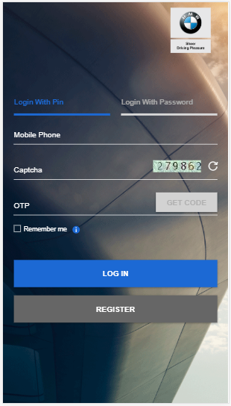
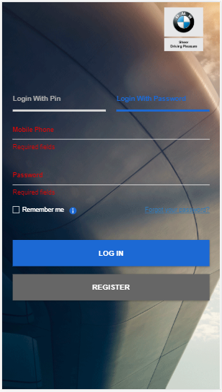
Story ID: ES-S 005
Mockups:
BMW Financial Services
Welcome!
App Introduction goes here,
Helpline: XX-XXXX-XXX
BMW Financial Services
Welcome!
Please Click here to understand our Application Process,
Helpline: XX-XXXX-XXX
Check Application Status
Create New Application.
Cancel & Goto Main Page
Login
Registration

Slide 20
Story ID: ES-S 005
Wireframes
Sample

Slide 21
Story ID: ES-S 005
Process Flow:
Easy Finance APP
Registration
Process

Slide 22
Story ID: ES-S 005
Sequence Flow

Slide 23
Story ID: ES-S 006:
OWNER: PO (BA)
Business
Legal
I want the Dealer automatically pre-filled so that I don't have to search for the specific dealer
Assumptions:
The vehicle and the transaction price is already negotiated offline between user and sales manager.
No pipeline check necessary.
User is logged in / registered.
Pre-Conditions:
User accepted location based services and GPS is usable
Acceptance Criteria:
Acceptance Criteria A
Acceptance Criteria B
Acceptance Criteria C
Acceptance Criteria D
IT
Compliance

Slide 24
Story ID: ES-S 006
Mockups:
Select Dealer by location based service. Prefill of:
- Province
- City
- Dealer

Slide 25
Story ID: ES-S 006
Wireframes
Sample

Slide 26
Story ID: ES-S 006
Process Flow:
Easy Finance APP
Registration
Process

Slide 27
Story ID: ES-S 006
Sequence Flow

